Slide 1
IoT-enabled Gas and Fire Detection
Group 6

Slide 2
Members:
Phạm Thu Hà
Hà Trung Thành
Nguyễn Tuấn Kiệt
Nguyễn Duy Phúc
Teacher: Dr. Phạm Văn Hà

Slide 3
Project Name
Unit 1. Introduction
1.1. Problem Statement
1.2. Motivation
1.3. Objectives
Unit 2. System Design
2.1. Hardware Design (Arduino IDE)
2.2. Node-RED Integration
2.3. InfluxDB Storage
Unit 3. System Implementation and Evalution
3.1. Test and Result
3.2. Advantages and Limitations
3.3. Future Work

Slide 4

1.1
Problem Statement
UNIT
01
Gas leaks and fire can happen anytime at home or in the kitchen.
People cannot see gas or feel fire early.
This is very dangerous. It can hurt people and damage homes.
We need a smart system to find gas or fire early and send a warning.

Slide 5
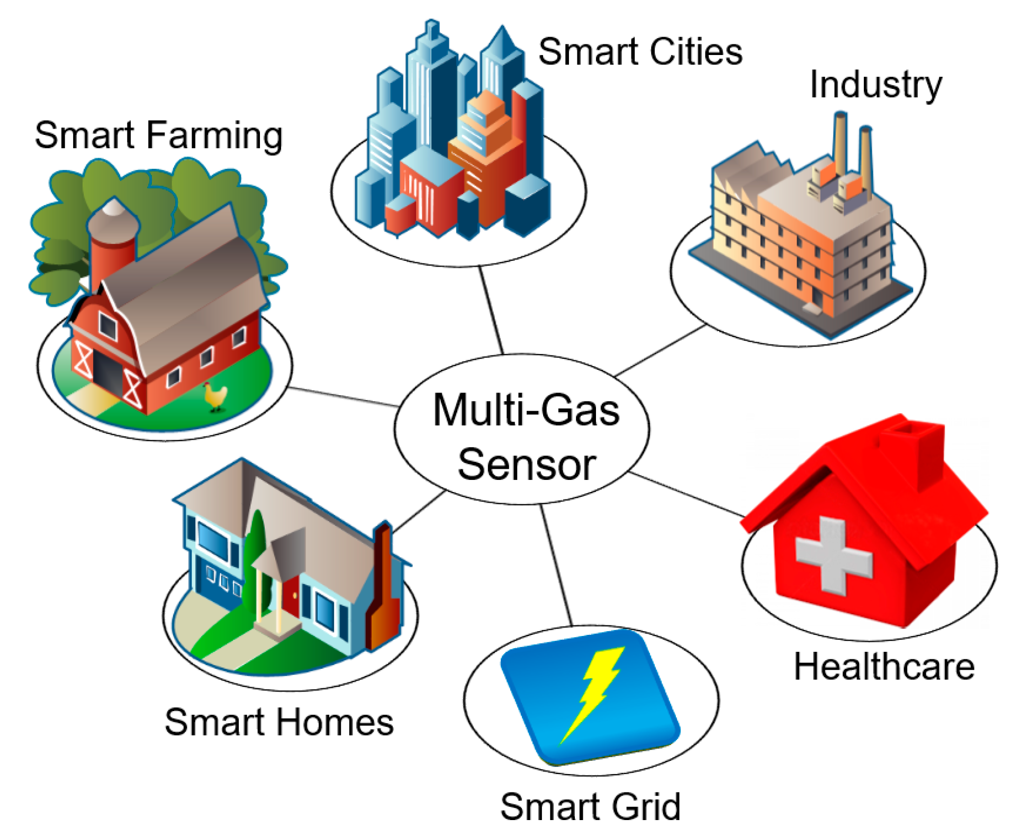
1.2
Motivation
01
Many accidents happen because of gas leaks or fire.
We want to help people stay safe using simple technology.
Sensors and Wi-Fi modules are now cheap and easy to use.
IoT can help us send data quickly to phones or computers.

Slide 6
1.3
Objectives
01
Our system will:
Detect dangerous gas and fire.
Turn on buzzer when danger happens.
Send sensor data to Node-RED dashboard.
Save data into InfluxDB to check later.

Slide 7

2.1
Hardware Design (Arduino IDE)
02
We use these parts:
MQ-2 Gas Sensor: finds gas.
Flame Sensor: detects fire (infrared light).
DHT22 Sensor: checks temperature and humidity.
ESP8266: connects all parts together.
Buzzer: for warning.
We write the code for Arduino using the Arduino IDE.

Slide 8

2.2
Node-RED Integration
02
The ESP8266 sends data to Node-RED using MQTT (Wi-Fi).
Node-RED dashboard shows:
Gas detection (yes/no)
Fire detection (yes/no)
Alerts (sound)
Temperature and humidity
Node-RED is free, simple, and works in real time.

Slide 9
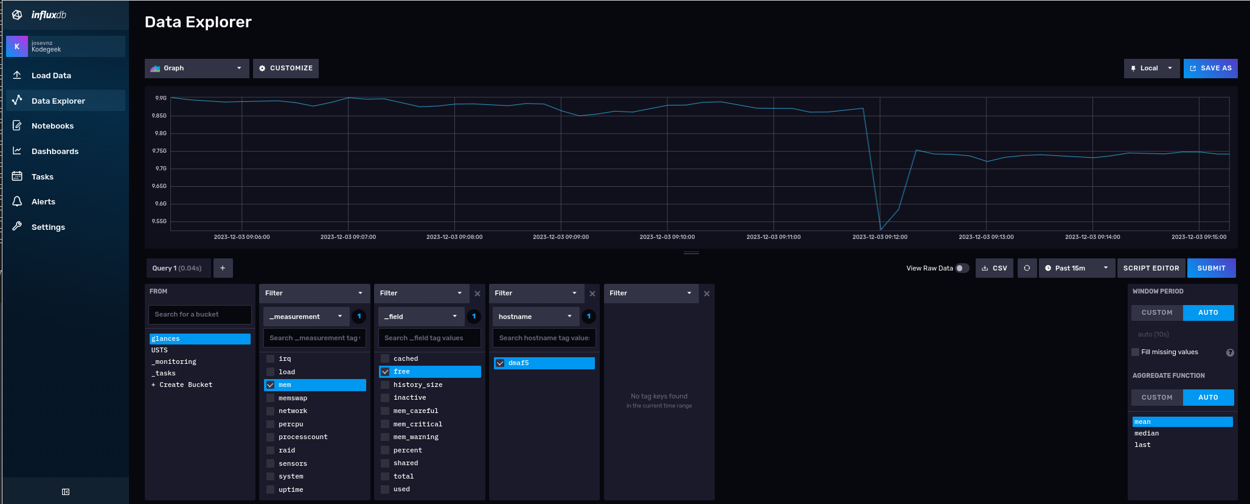
2.3
InfluxDB Storage
02
We use InfluxDB to save all sensor data.
It helps us check the history of temperature and humidity.
We can draw charts and graphs from this data to study danger over time.

Slide 10
3.1
Test and Result
03
We tested the system using:
A lighter (for fire)
Gas spray (for gas sensor)
System detects danger in 1–2 seconds.
Buzzer turns on
Data is saved in InfluxDB.

Slide 11
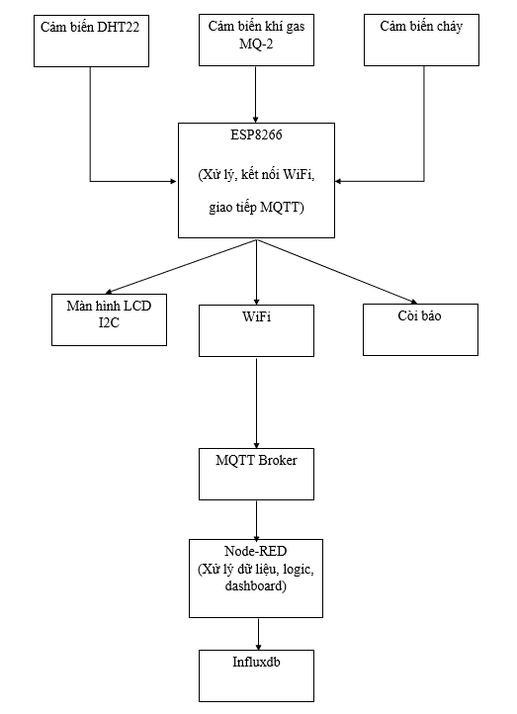
3.1
Test and Result
03
Block diagram

Slide 12
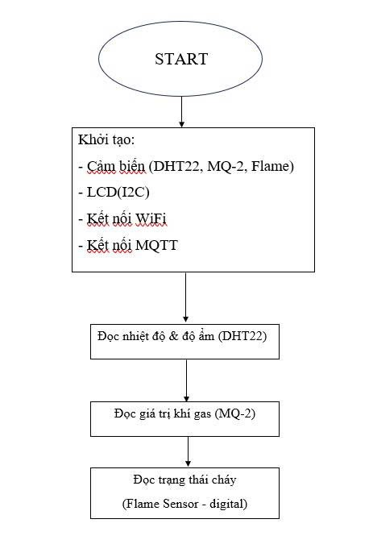
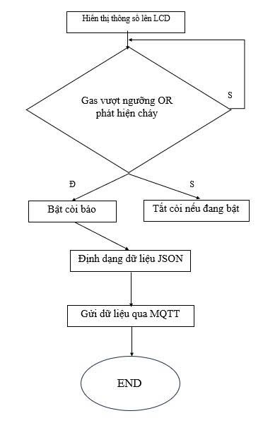
3.1
Test and Result
03
Flow chart

Slide 13
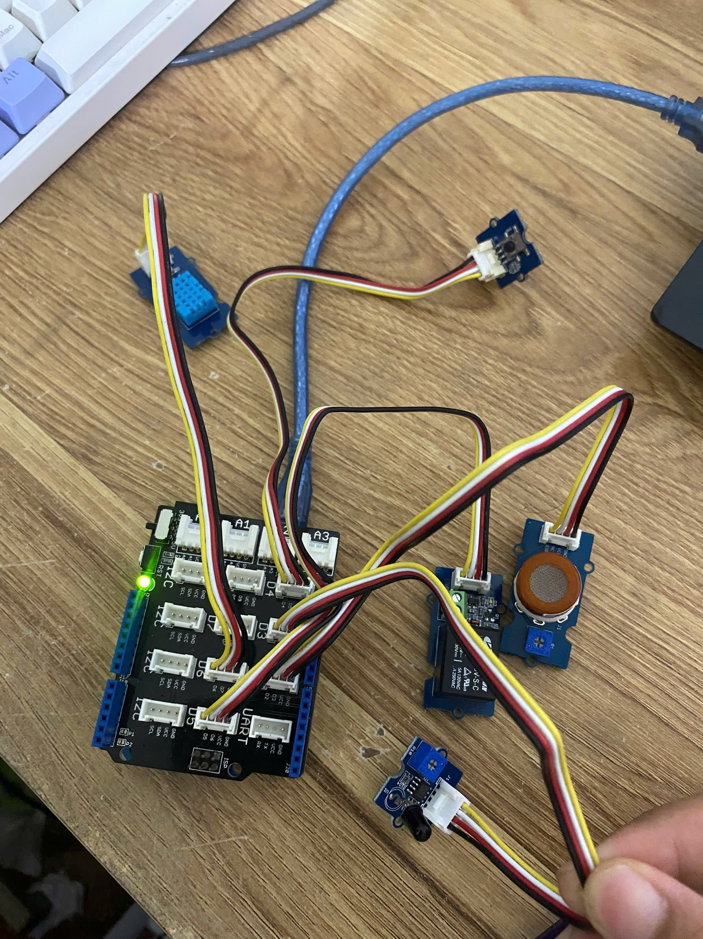
3.1
Test and Result
03
This is our product

Slide 14
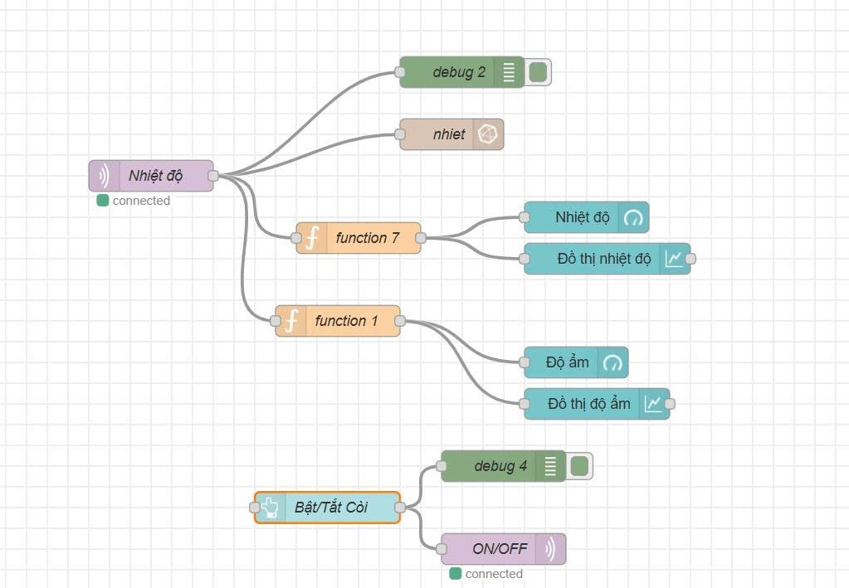
3.1
Node-RED Integration
03
Node-RED Interface

Slide 15
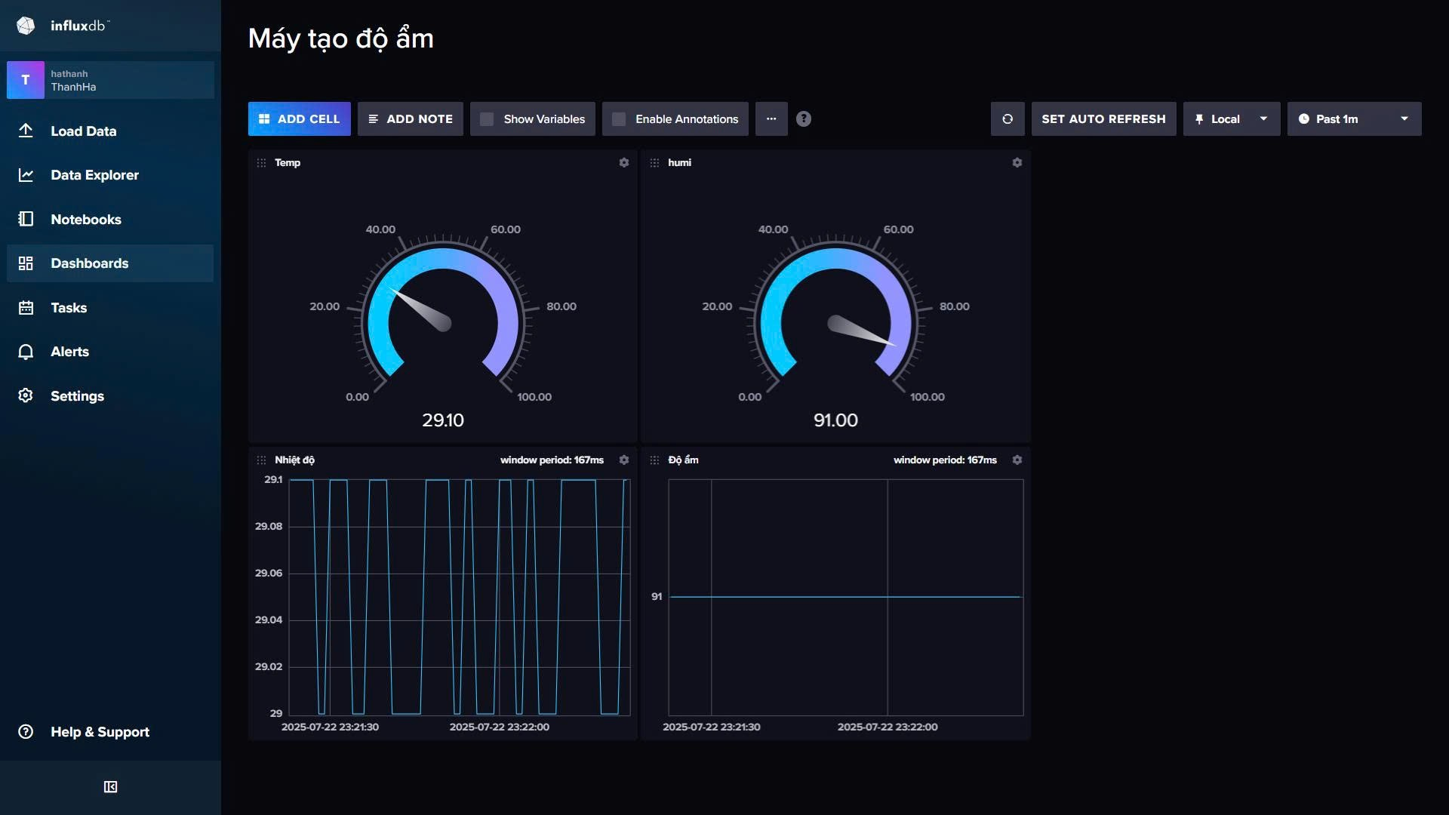
3.1
Test and Result
03
Data is saved in InfluxDB.

Slide 16
3.2
Advantages and Limitations
03
Advantages:
Fast and early warning
Low cost and easy to use
Check data from anywhere
Data saved for later use
Can be upgraded easily

Slide 17
3.2
Advantages and Limitations
03
Limitations:
Needs Wi-Fi to send data.
Flame or gas sensor may not work well in hot or wet places.
Node-RED needs to run on a computer or Raspberry Pi.

Slide 18
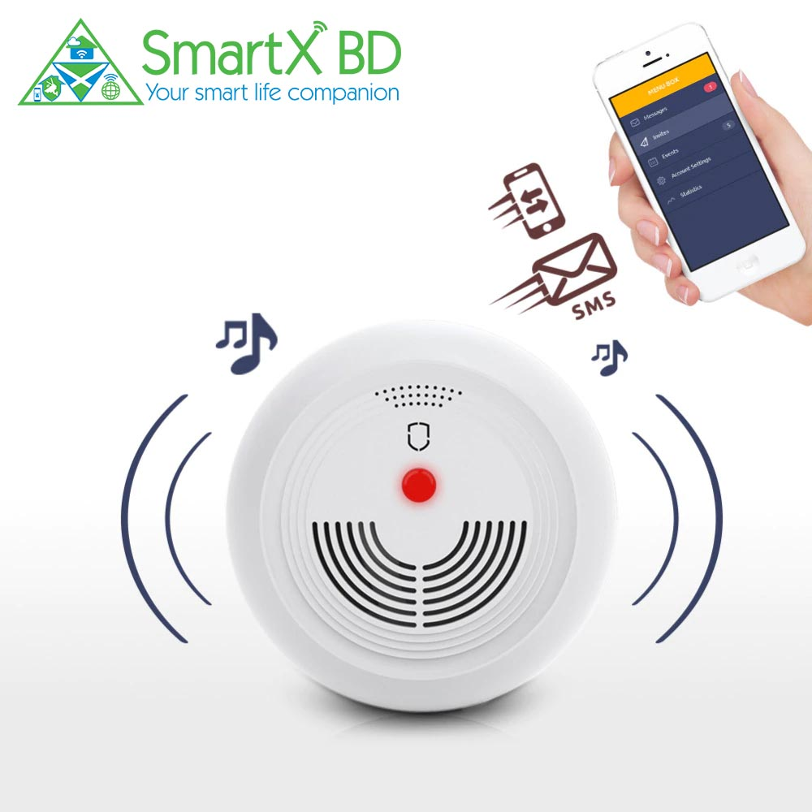
3.3
Future Work
03
In the future, we want to:
Add SMS or email alerts when Wi-Fi is lost.
Add more sensors: temperature, smoke, CO2.
Use AI to learn danger patterns from data.
Make a version with battery and 4G for mobile use.

Slide 19
Thank You!

